Slide 1

Submitted To: Dr Amit Chauhan
Assistant Professor
SCSET, Bennett University
Presented By:
Aditya Purohit

Slide 2
Contents
Project Overview: Introduction to Traffic-V and its core objectives.
System Architecture: High-level design and component interaction.
Core Modules:
  Vehicle Detection & Classification
  License Plate Recognition (ANPR)
  Advanced Color Analysis
Processing Pipeline: From video input to actionable data.
Tracking & Analytics: Object tracking logic and database management.
Technology Stack: Libraries and frameworks utilized.
Live Demonstration: Overview of the user interface and features.
Future Scope: Potential enhancements and scalability.

Slide 3
Introduction
Traffic-V is an advanced, automated system designed for real-time vehicle monitoring and analysis.
Problem Statement: Traditional traffic monitoring is manual, error-prone, and lacks detailed analytics like vehicle color or precise classification.
Our Solution: A comprehensive software pipeline that integrates computer vision and deep learning to automate:
  Vehicle Detection: Identifying cars, trucks, buses, and motorbikes.
  License Plate Recognition: Extracting and reading alphanumeric plates.
  Attribute Analysis: Determining vehicle color with high accuracy.
Key Goal: To provide a robust, scalable tool for traffic management, security surveillance, and smart city applications.

Slide 4
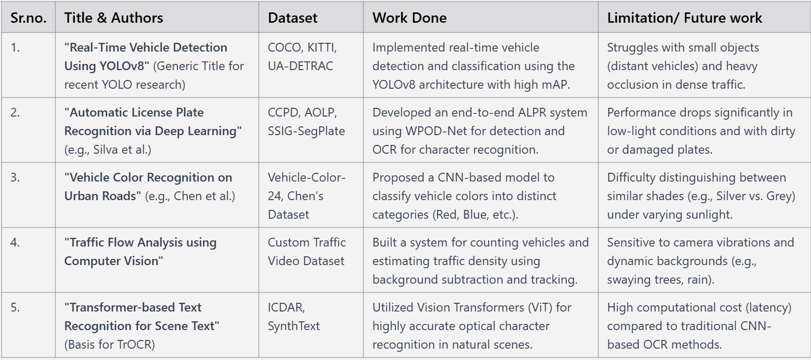
Literature Review
(NOTE: Add Minimum 5 Research Papers)

Slide 5
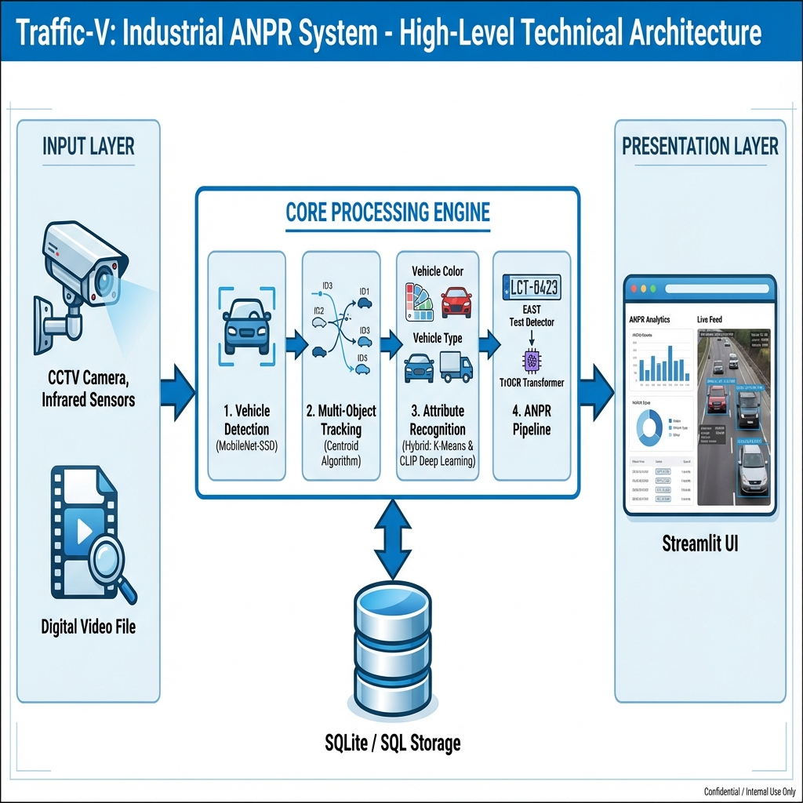
Workflow

Slide 6
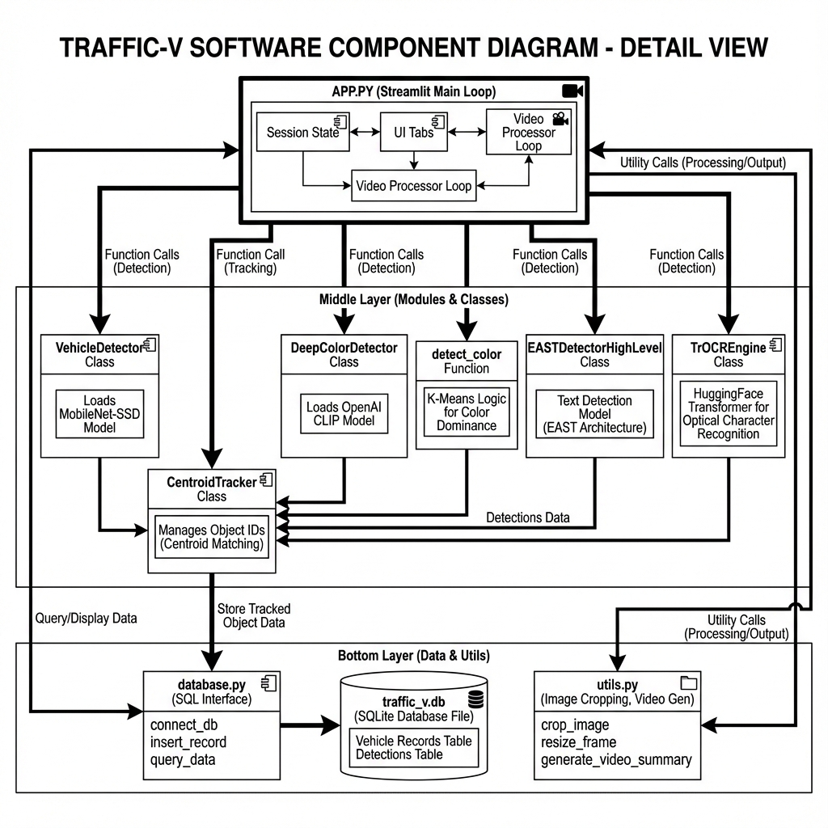

Slide 7
Proposed Methodology
Input Acquisition: Video stream or video file is ingested.
Vehicle Detection: MobileNet SSD (Single Shot Detector) model identifies vehicles and draws bounding boxes.
Object Tracking: Centroid tracking algorithm assigns unique IDs to keep track of vehicles across frames.
Attribute Analysis:
  Color: Hybrid approach using K-Means Clustering and Deep Learning (CLIP) for precise color naming.
  Plate Detection: EAST (Efficient and Accurate Scene Text) detector locates the license plate.
Recognition (OCR): TrOCR (Transformer-based OCR) reads the text from the plate region.
Data Logging: All data (ID, Type, Color, Plate, Time) is saved to an SQLite database.

Slide 8
References (IN IEEE format)
W. Liu et al., "SSD: Single Shot MultiBox Detector," in European Conference on Computer Vision (ECCV), 2016, pp. 21–37.
X. Zhou et al., "EAST: An Efficient and Accurate Scene Text Detector," in Proceedings of the IEEE Conference on Computer Vision and Pattern Recognition (CVPR), 2017, pp. 5551–5560.
M. Li et al., "TrOCR: Transformer-based Optical Character Recognition with Pre-trained Models," in Proceedings of the AAAI Conference on Artificial Intelligence, vol. 37, no. 11, pp. 13094–13102, 2023.
A. Radford et al., "Learning Transferable Visual Models From Natural Language Supervision," in Proceedings of the International Conference on Machine Learning (ICML), 2021, pp. 8748–8763.
S. M. Silva and C. R. Jung, "License Plate Detection and Recognition in Unconstrained Scenarios," in Proceedings of the European Conference on Computer Vision (ECCV), 2018, pp. 580–596.

Slide 9
Thank YOU

